Slide 1
OO Design Patterns
Coding Cleverly
Notes:
1

Slide 2
Why design pattern
Design patterns make code :
Reusable
Common building blocks most programmers know
Add functionality in the simplest way
See Repository for code examples!
Notes:
2

Slide 3
Types of Design patterns
Creational
Create objects but hide details of creation logic
Structural
Concern composition, aggregation, inheritance
Behavioral
Concerning communication between objects

Slide 4
Today’s Agenda
Observer
Strategy
Factory
Decorator
Adapter
Singleton
Proxy
Patterns we will cover

Slide 5
Observer
When there is one-to-many relationship between objects such as if one object is modified, its dependent objects are to be notified automatically
Falls under behavioral pattern category
Notes:
5

Slide 6
Strategy
The same object needs to have different behaviours at different times when running the program
Behavior pattern
Notes:
6

Slide 7
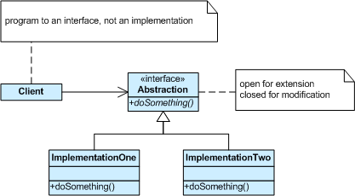
Strategy
Notes:
7

Slide 8
Factory
Create objects at runtime without exposing the code to the client
Creational pattern
Notes:
8

Slide 9
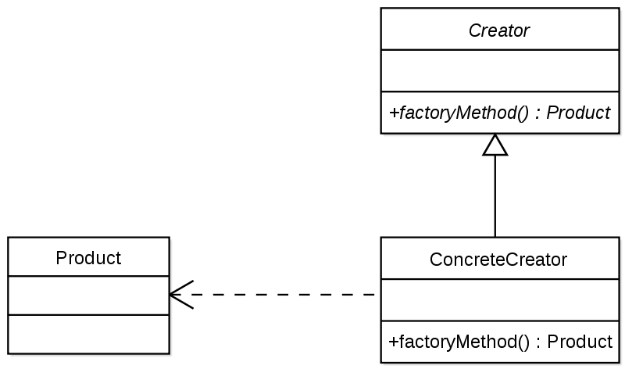
Factory
Notes:
9

Slide 10
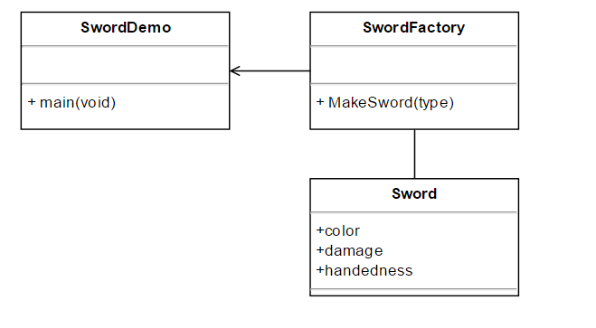
Factory
Notes:
10

Slide 11
Decorator Pattern
Add new functionality to an existing object without altering its structure
Structural pattern
Notes:
11

Slide 12
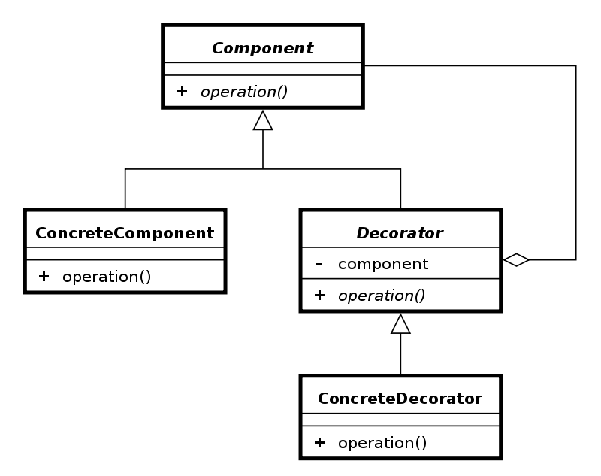
Decorator Pattern
Notes:
12

Slide 13
Adapter
Makes an old piece of code (e.g. code taken from the internet) function with our current project
Works as a bridge between two incompatible interfaces
Structural pattern
Notes:
13

Slide 14
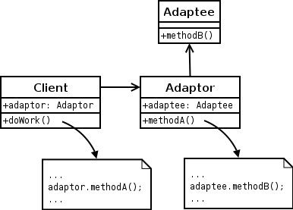
Adapter
Notes:
14

Slide 15
Singleton
Involves a single class which is responsible to create an object while making sure that only single object gets created
Creational pattern
Notes:
15

Slide 16
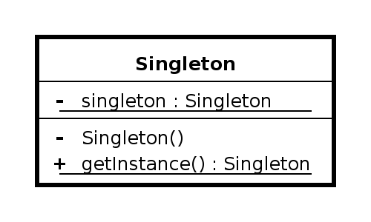
Singleton
Notes:
16

Slide 17
Singleton
Steps:
Add a static instance of the class
Make constructor Private
Make a static getter method for the instance
Notes:
17

Slide 18
Proxy
Class represents functionality of another class
Structural pattern
Notes:
18

Slide 19
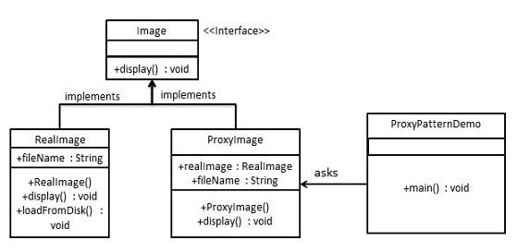
Proxy
Notes:
19

Slide 20
References
http://www.tutorialspoint.com/design_pattern/design_pattern_overview.htm
Factory: https://www.youtube.com/watch?v=ub0DXaeV6hA

